Slide 1
Emotion Detection
Ali Baran Tasdemir – Akif Cavdar

Slide 2
Introduction
We worked on emotion analysis for textual expressions.
Implemented deep learning methods and some traditional Machine Learning methods.
Support Vector Machine
Logistic Regression
Multinomial Naïve Bayes
CNN & RNN

Slide 3
Motivation
Main motivation is, maximizing human-machine interaction.
Document categorizing
Improving for Chatbots.
Personal assistant systems.
Social media analysis for marketing.

Slide 4
Dataset
We used ISEAR dataset
7503 sentences, 7 different emotion label
Dataset | Anger | Disgust | Fear | Guilt | Joy | Sadness | Shame | Total
ISEAR | 1070 | 1058 | 1079 | 1070 | 1065 | 1080 | 1081 | 7503

Slide 5
Emotion Detection
Emotion detection is a classification problem. We basically categorize sentences with given(dataset labels) emotions.
We use traditional machine learning methods and deep learning methods for classification.
Emotional responding of any people can differ by culture, growth area etc.

Slide 6
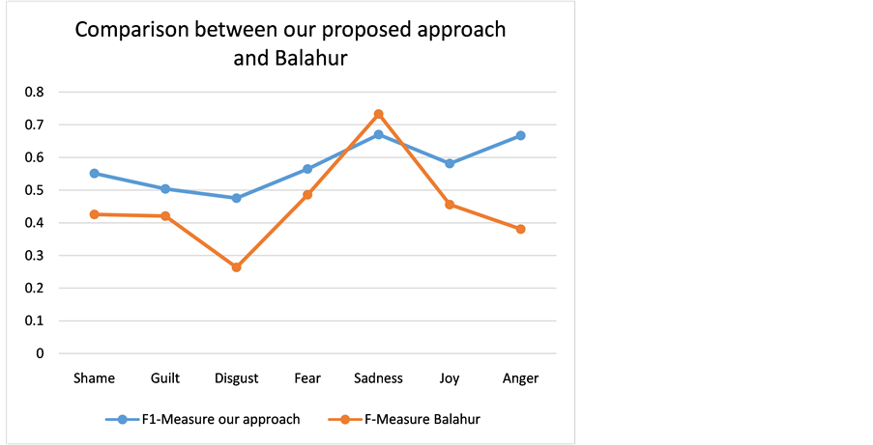
Related Works
Text-Based Intelligent Learning Emotion
System
**Multiclass Emotion Extraction from Sentences
Emotion | Accuracy
Anger | 68.94
Disgust | 69.76
Fear | 83.06
Guilt | 80.67
Joy | 78.3
Sadness | 79.16
Shame | 78.84

Slide 7
Methods
Preprocessing
Multinomial Naïve Bayes
Logistic Regression
SVM
CNN & RNN

Slide 8
Preprocessing
Stopwords
Tf-Idf (Term frequency – inverse document frequency)
Stemming

Slide 9
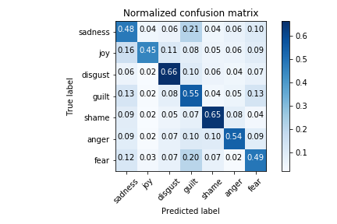
Multinomial Naïve Bayes
Hyper-parameters / Models
Stemming, Bigram, Tf-Idf, Laplace Smoothing
Result
 | Precision | Recall | F1-Score
Micro Avg. | 0.55 | 0.55 | 0.55
Macro Avg. | 0.56 | 0.55 | 0.55
Weigthed Avg. | 0.57 | 0.55 | 0.55

Slide 10
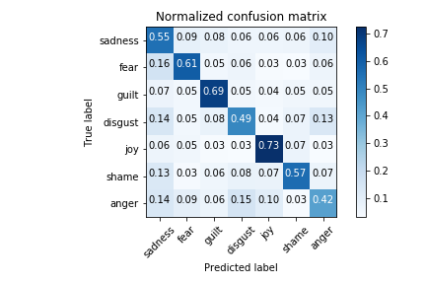
Logistic Regression
Hyper-parameters / Models
Stemming, Unigram, Tf-Idf, L2 Regularization
Result
 | Precision | Recall | F1-Score
Micro Avg. | 0.58 | 0.58 | 0.58
Macro Avg. | 0.58 | 0.58 | 0.58
Weigthed Avg. | 0.58 | 0.58 | 0.58

Slide 11
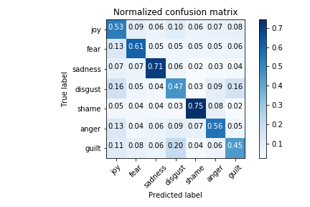
SVM
Hyper-parameters / Models
Stemming, Bigram, L2 Regularization, Squared Hinge (L2) Loss Function
Result
 | Precision | Recall | F1-Score
Micro Avg. | 0.58 | 0.58 | 0.58
Macro Avg. | 0.58 | 0.58 | 0.58
Weigthed Avg. | 0.58 | 0.58 | 0.58

Slide 12
*GloVe: Global Vectors for Word Representation
GloVe is an unsupervised learning algorithm for obtaining vector representations for words. Words represented as vectors in n-dimensional vector space.
We used Wikipedia 2014 + Gigaword 5
400k vocabulary
6B tokens
100-dimensional vectors

Slide 13
CNN
Adam Loss Function, Softmax activation, 10 epoch, categorical cross-entropy loss function,
Layer(type) | Output Shape | Param #
Embedding | (None, 100, 100) | 2000100
Dropout | (None, 100, 100) | 0
Conv1D (reLu) | (None, 96, 64) | 32064
Max-Pooling | (None, 24, 64) | 0
LSTM | (None, 100) | 66000
Dense (Softmax) | (None, 7) | 707
Total parameters = 2,098,871

Slide 14
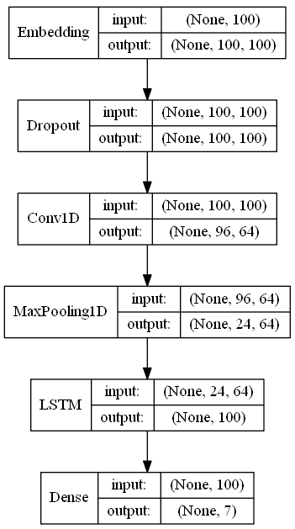

Slide 15
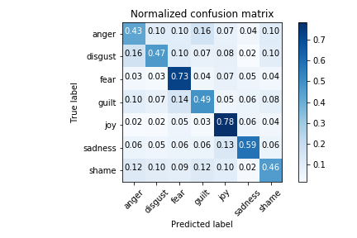

Slide 16
Bidirectional LSTM
Adam Loss Function, Softmax activation, 10 epoch, categorical cross-entropy loss function,
Layer(type) | Output Shape | Param #
Embedding | (None, 100, 100) | 2000100
Bidirectional LSTM | (None, 200) | 160800
Dense (Softmax) | (None, 7) | 1407
Total parameters = 2,162,307

Slide 17
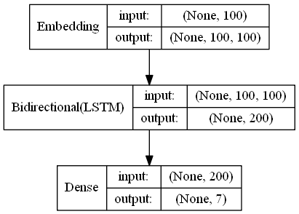

Slide 18
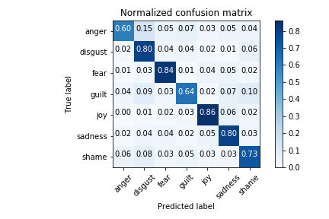

Slide 19
Bidirectional LSTM
Emotion | Accuracy (%)
Anger | 60.28
Disgust | 80.38
Fear | 84.21
Guilt | 63.76
Joy | 86.12
Sadness | 80.38
Shame | 73.20
Overall | 75.48
We get best results.
75.48% overall test score.

Slide 20
Comparing to Related Works
 | Accuracy (%)
Emotion | Our Method | *Bincy Thomas, Vinod P, Dhanya K A
Anger | 60.28 | 68.94
Disgust | 80.38 | 69.76
Fear | 84.21 | 83.06
Guilt | 63.76 | 80.67
Joy | 86.12 | 78.3
Sadness | 80.38 | 79.16
Shame | 73.20 | 78.84
Overall | 75.48 | 76.96

Slide 21
Conclusion
Disgust | When I witnessed an accident. | Sadness
Fear | The first time that I saw a dead person, this was when I started my gross anatomy practicals. | Disgust
Shame | When I am angry at someone without a good reason. Later on it he proves that he didn't do anything wrong. | Anger
Emotions are personal to generalize
Textual expression sometimes contains irony.

Slide 22
Q & A

